Slide 1

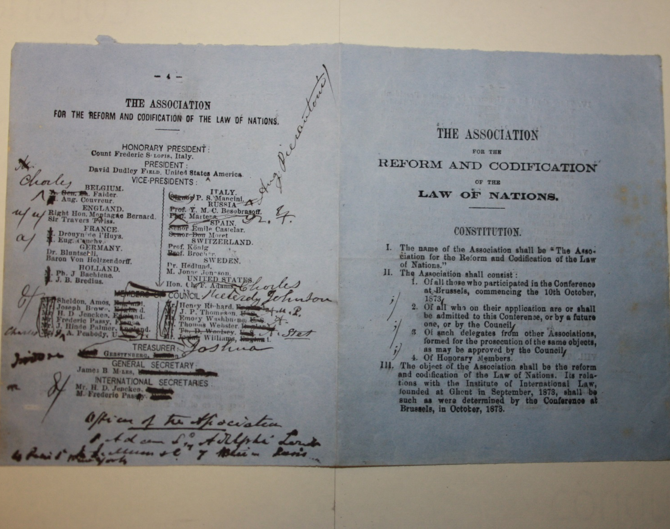
The International Law Association
Founded in Brussels in 1873 as an association 'to consist of Jurists, Economists, Legislators, Politicians and others taking an interest in the question of the reform and Codification of Public and Private International Law, the Settlement of Disputes by Arbitration, and the assimilation of the laws, practice and procedure of the Nations in reference to such laws'

Slide 2
Context
1840 - 'An Essay on a Congress of Nations': William Ladd proposes the idea of creating an assembly to codify international law
1850 - Elihu Burritt elaborates on this at the International Congress of the Friends of Peace in Frankfurt
1863 - Foundation of the Red Cross
1864 - Approval of the Geneva Convention, the first codified international treaty that covered the sick and wounded soldiers in the battlefield
1873 - Formation of both the Association for the Reform and Codification of the Law of Nations and l'Institut de Droit International/the Institute for International Law

Slide 3
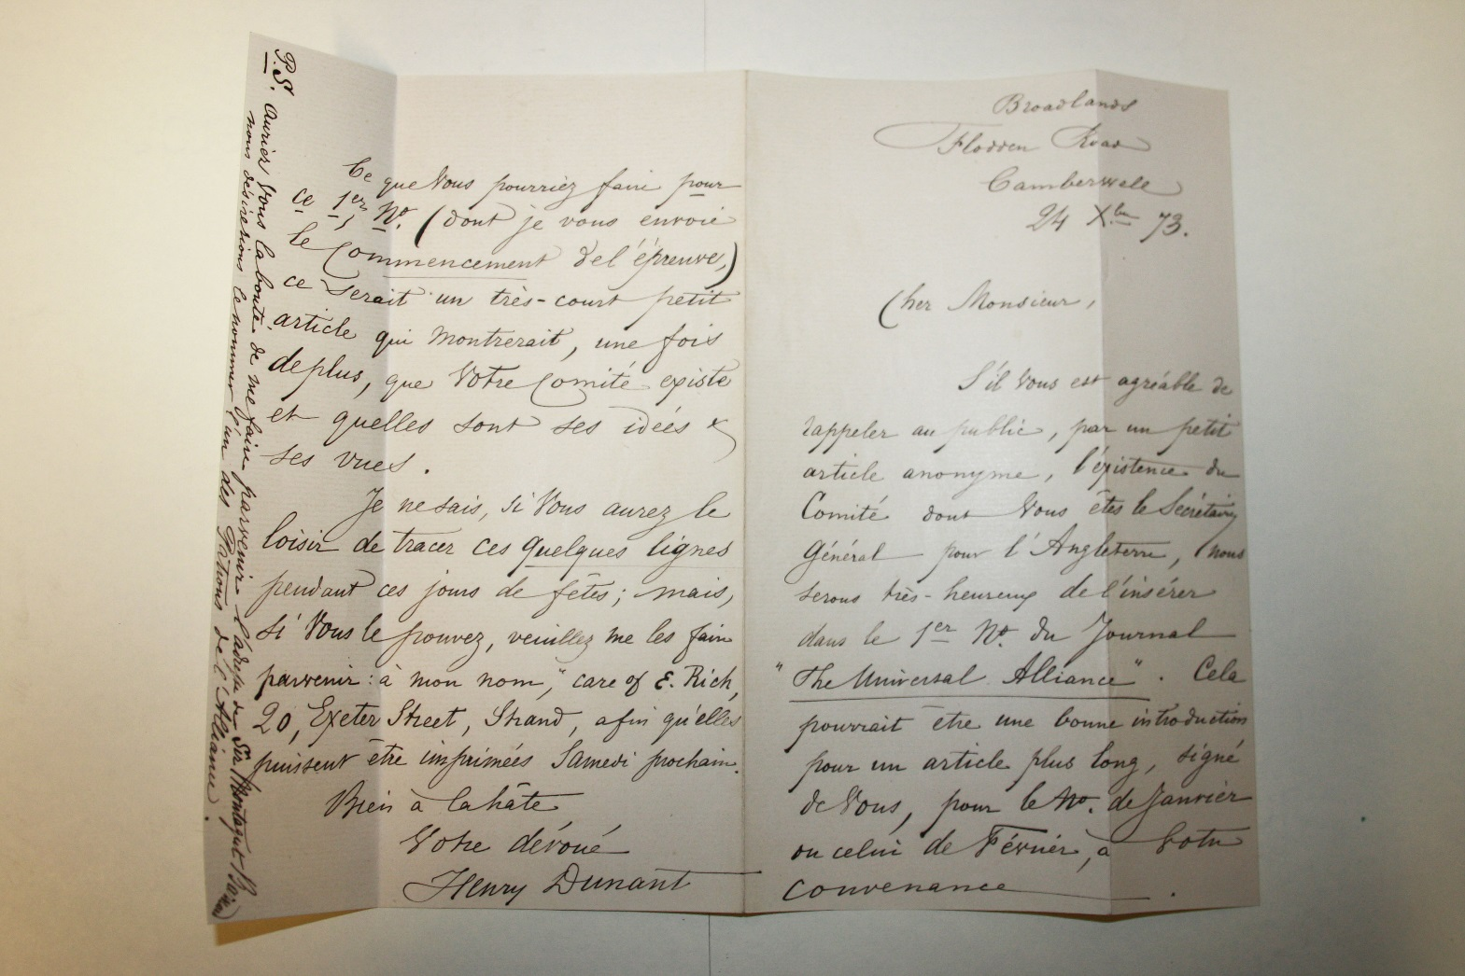
Letter from Henri Dunant (ILA 1/7/1)

Slide 4
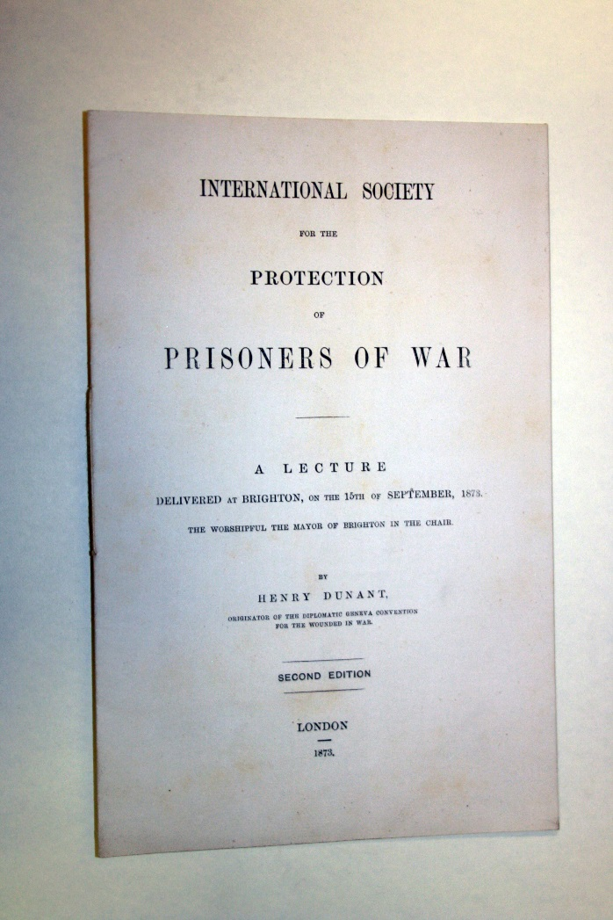
Lecture delivered by Henry Dunant to the International Society for the Protection of Prisoners of War (ILA/1/7/1)

Slide 5
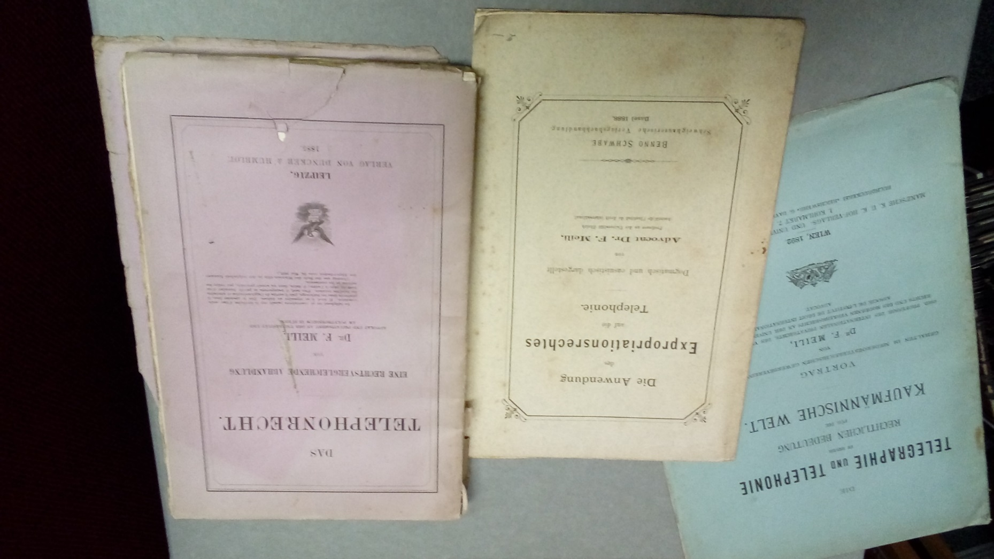
Legal implications of telephony and telegraphy (ILA/6/15)

Slide 6
Archives of the International Law Association at IALS
Papers of the Executive Council, 1873-2004: these include early constitutional and membership documents; finance documents; papers of officers of the Executive Council.
Papers of the ILA Conference, 1874-1998.
Papers of the ILA regional branches.
Papers of the ILA International Committees.
Papers of the Grotius Society.
Library material.

Slide 7
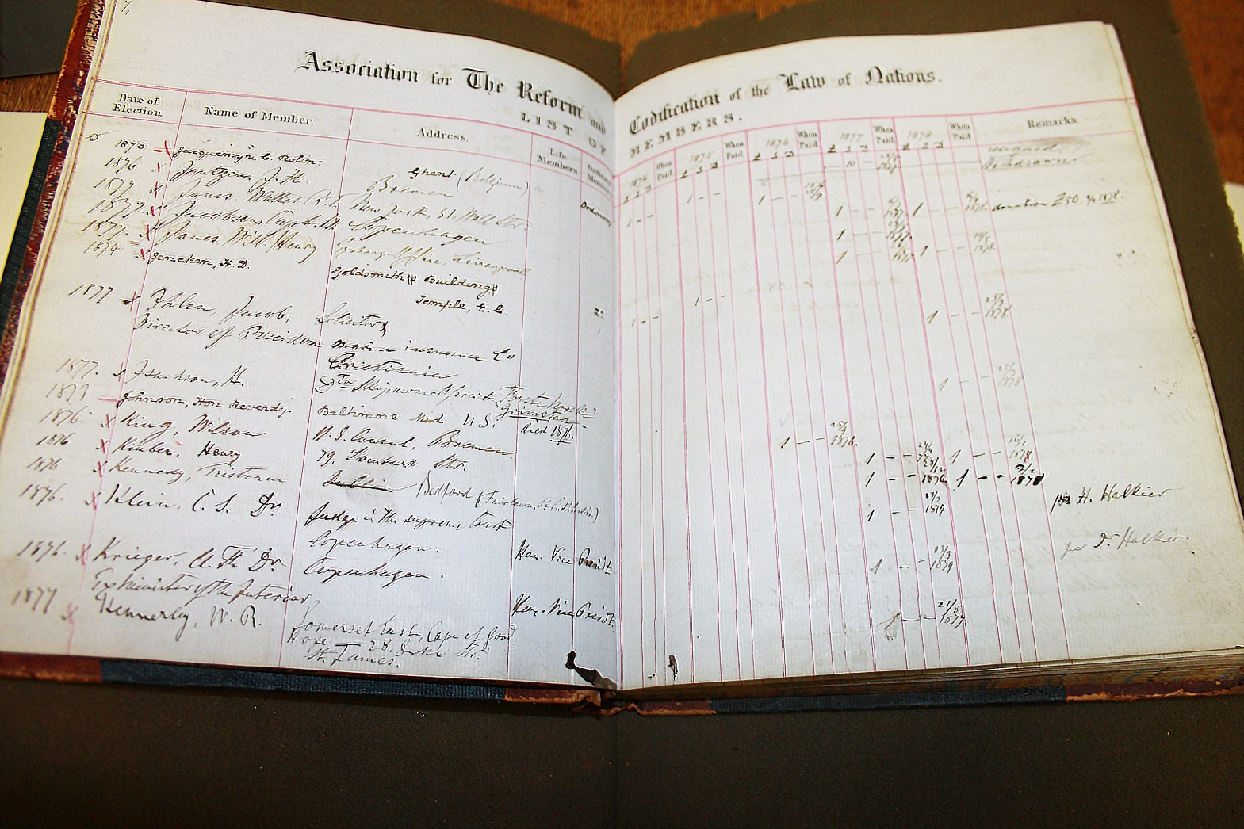
Membership book, 1874-1878 (ILA 1/2/1)

Slide 8
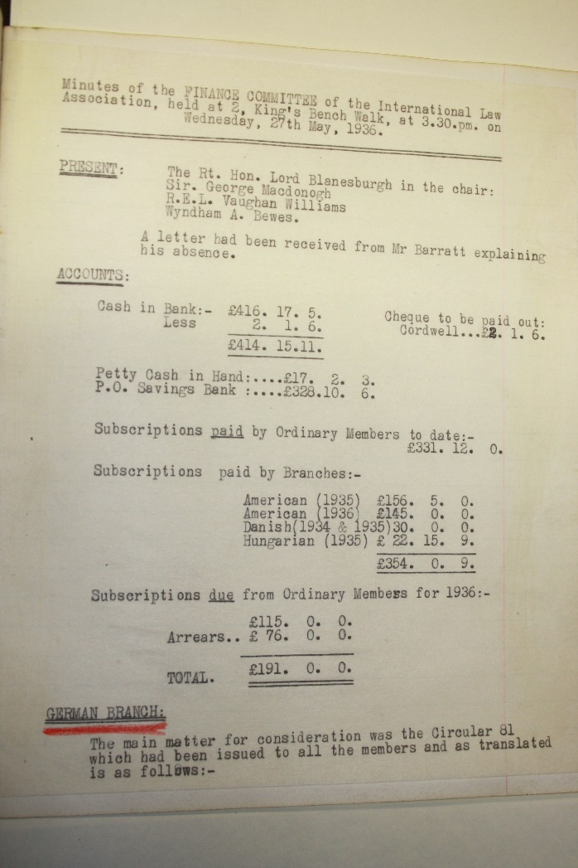
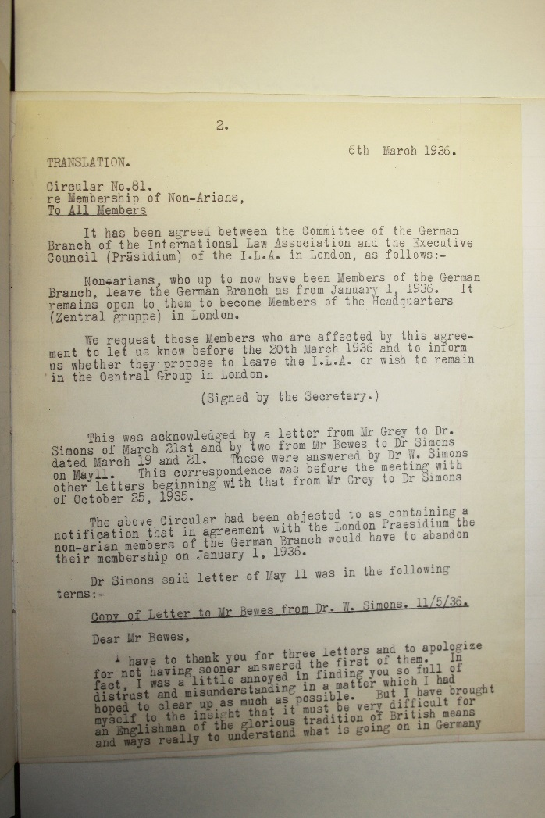
Finance committee minutes, 1936 (ILA/1/3/4/1)

Slide 9
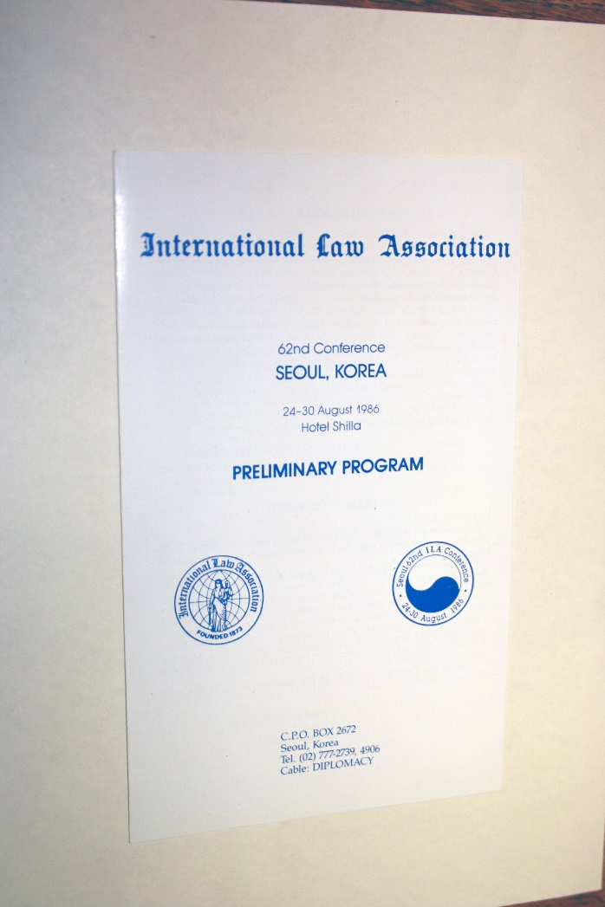
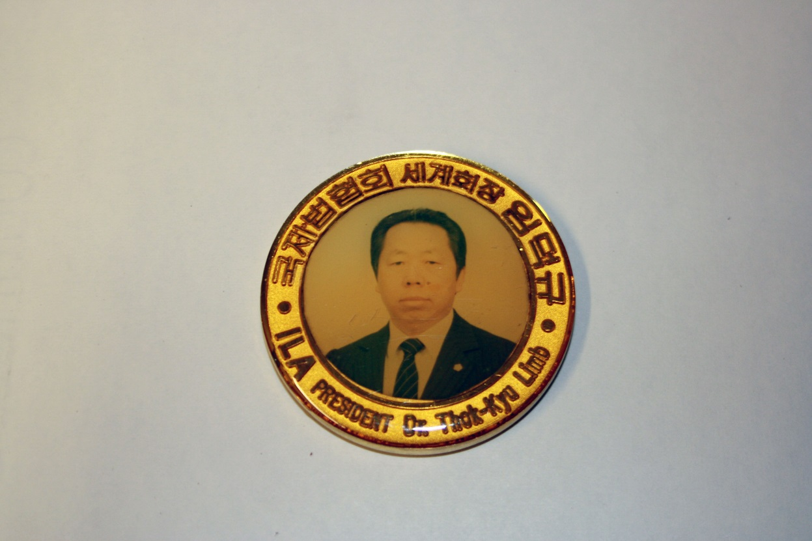
Ephemera from the 62nd ILA conference in Seoul, 1986 (ILA 2/40/10)

Slide 10
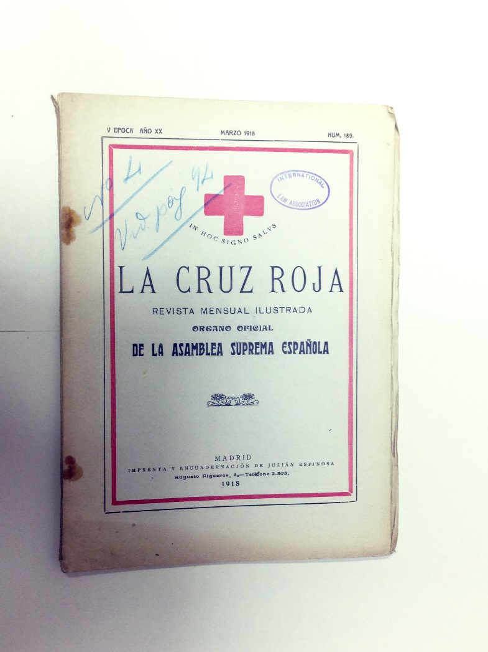
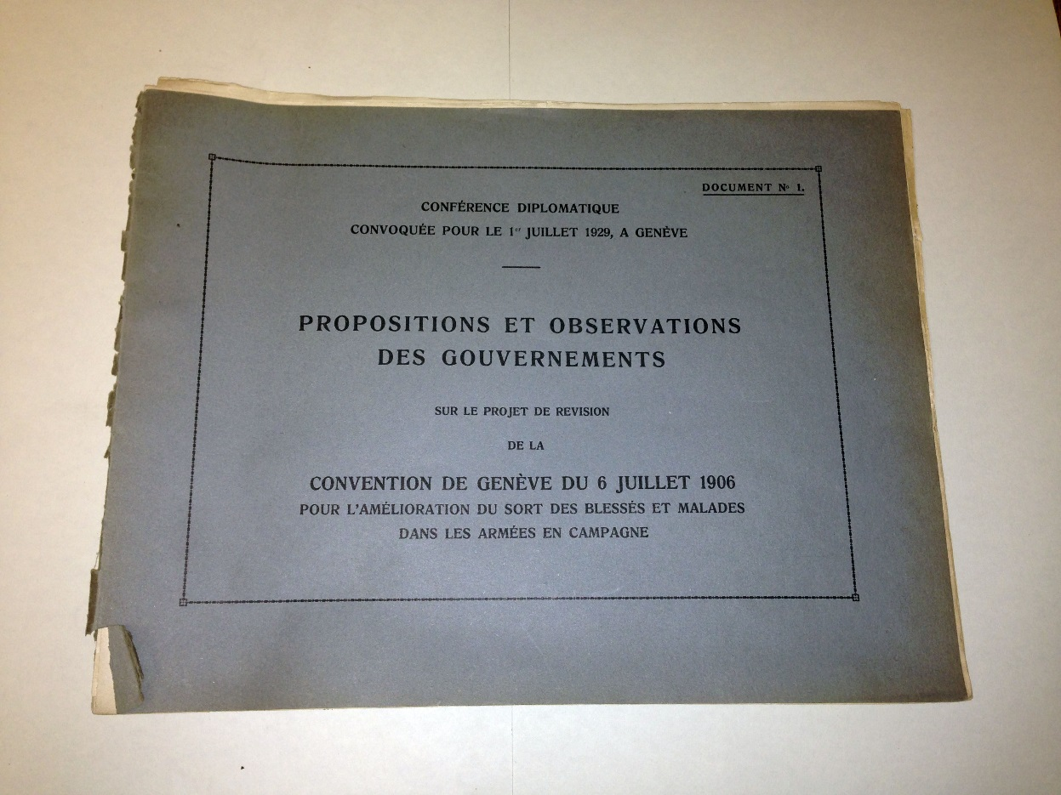
Reference material for the Treatment of Prisoners of War Committee (ILA/3/11/2)

Slide 11
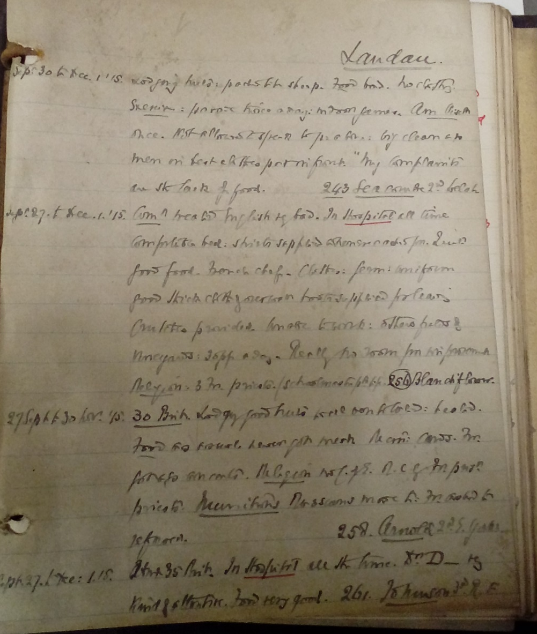
Reference material for the Treatment of Prisoners of War Committee Parliamentary Submission (ILA/3/11/2)

Slide 12
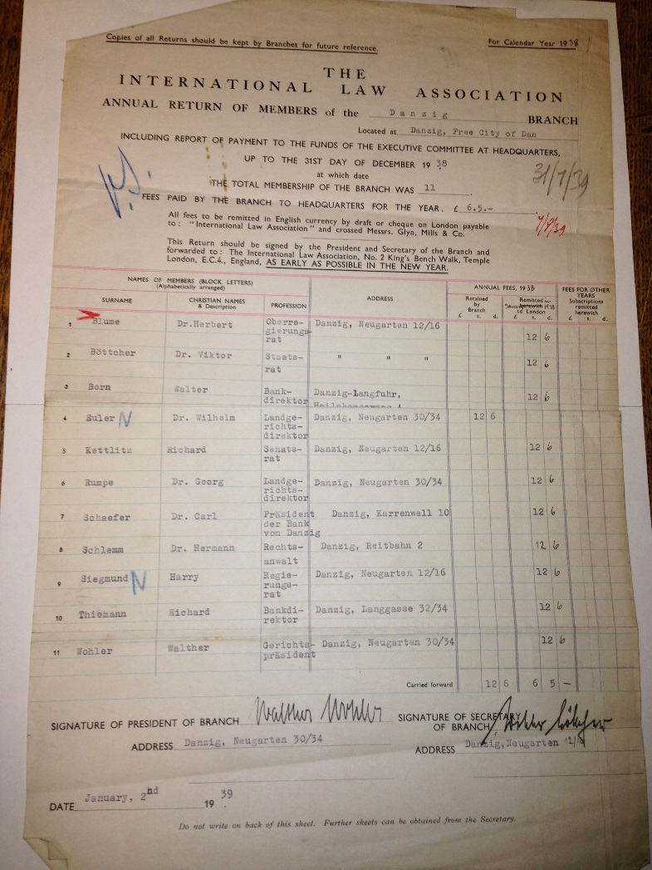
Annual return of the Free City of Danzig branch of the International Law Association, 1936-1938 (ILA 4/14/1)

Slide 13
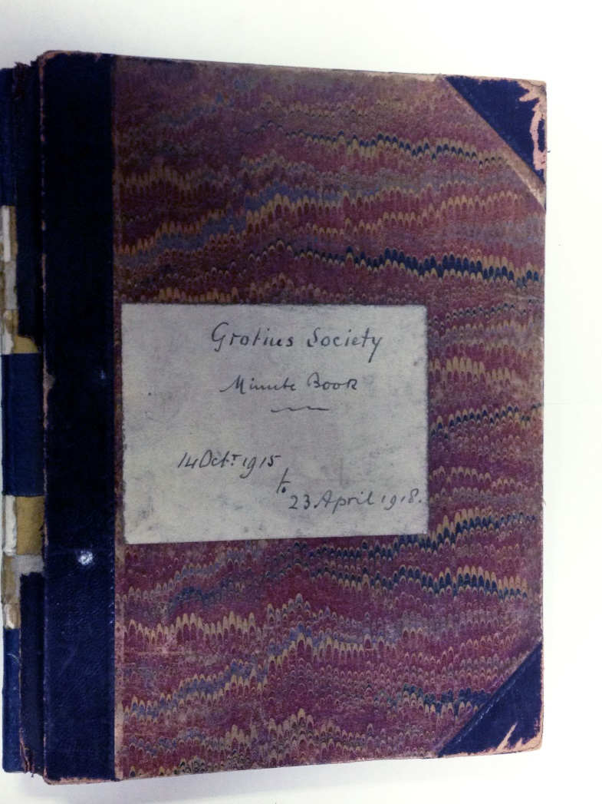
Grotius Society minute book, 1915-1918 (ILA/5/1/1)

Slide 14
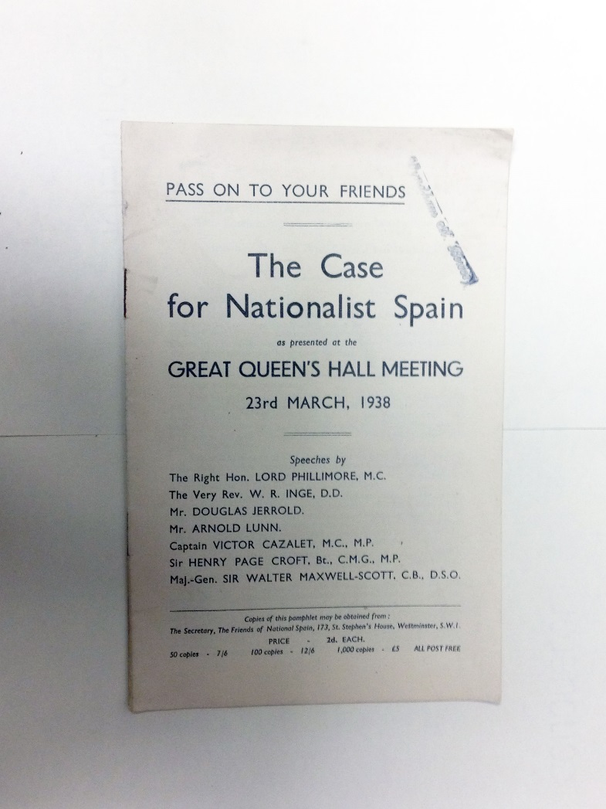
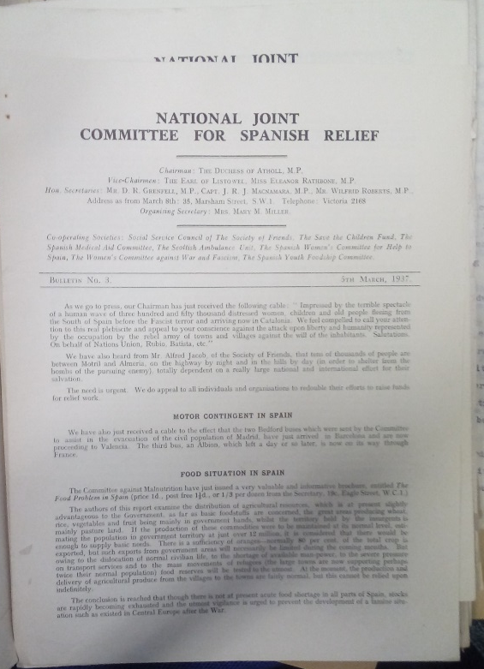
‘The Spanish Civil War and other matters’
(ILA/6/9)

Slide 15
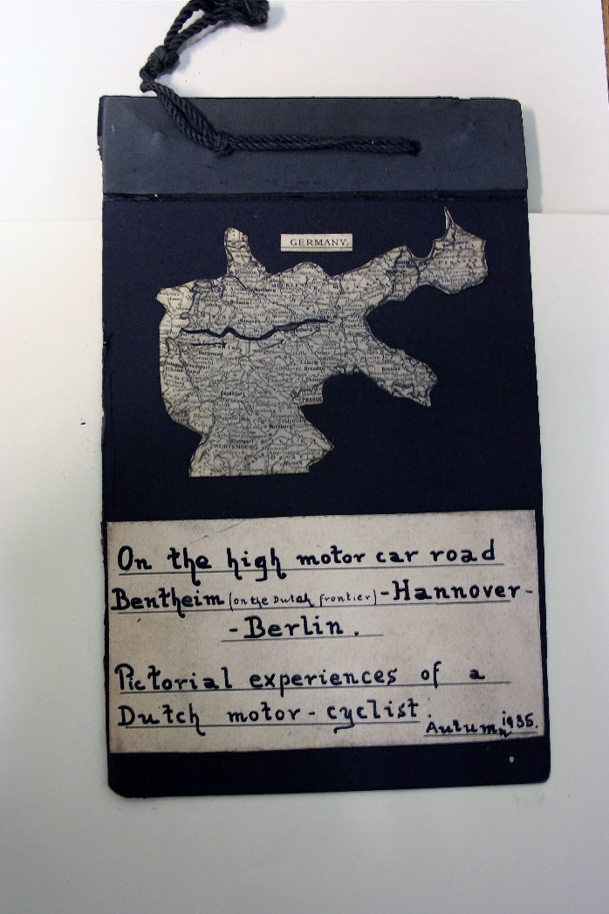
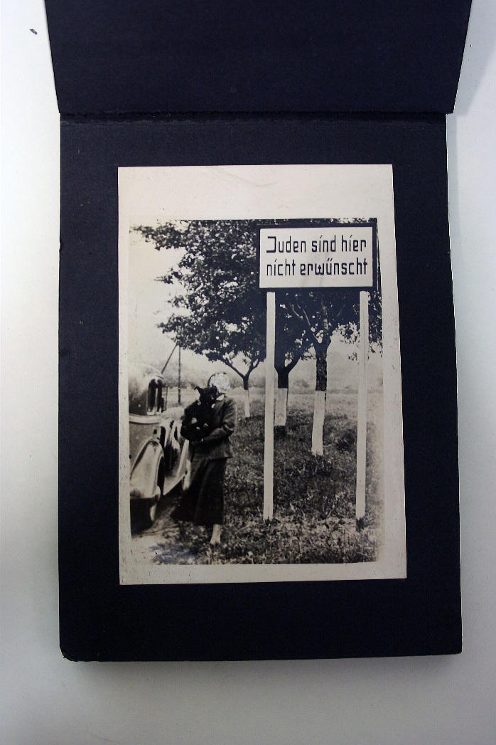
‘The Persecution of the Jews in Germany’
(ILA/6/12)

Slide 16
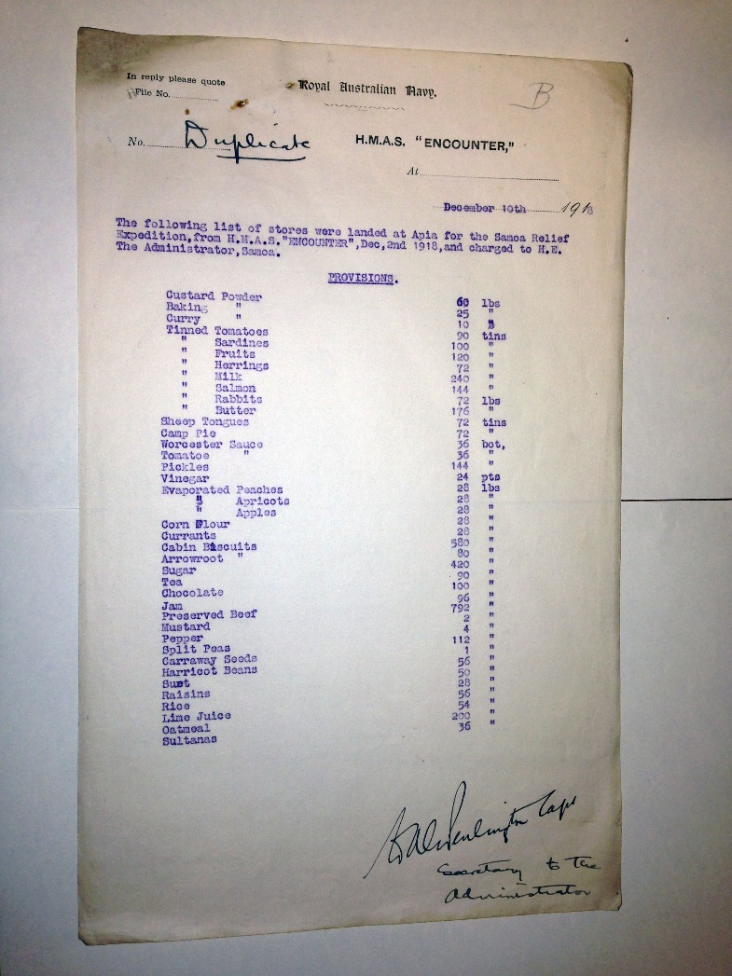
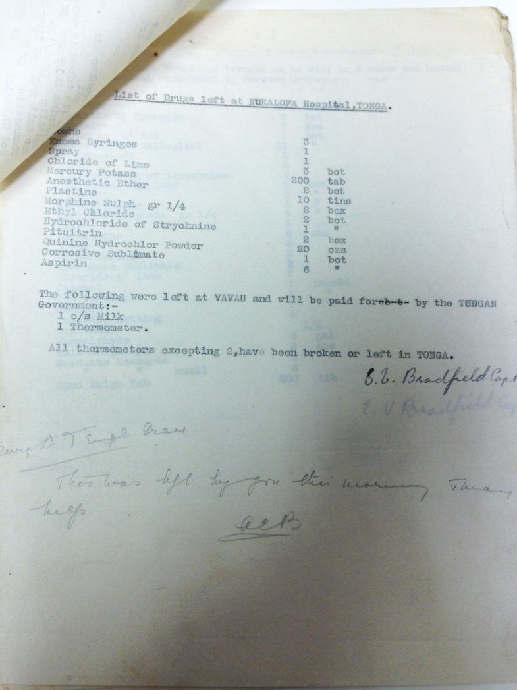
Papers of Francis Temple Grey

Slide 17
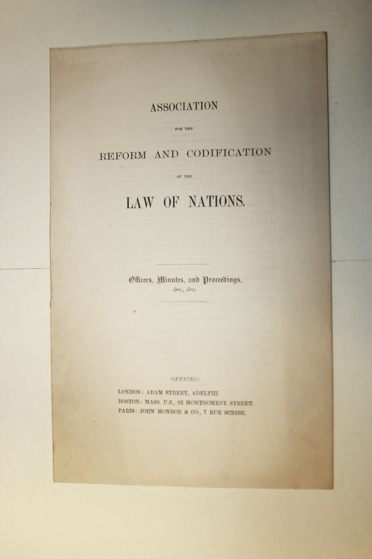
Catalogue available on IALS website from spring 2017 (see http://ials.sas.ac.uk/library/archives/archive.htm)
Access by advance appointment (email: ials@sas.ac.uk or telephone 020 7862 5790).
Laptops or pencil notes only, and no food or drink, please, to help preserve our archives!
Digital non flash photography may be permitted under supervision (subject to copyright regulations)

