Slide 1
A (Very) Brief Introduction to the German Historical Institute Library

Slide 3
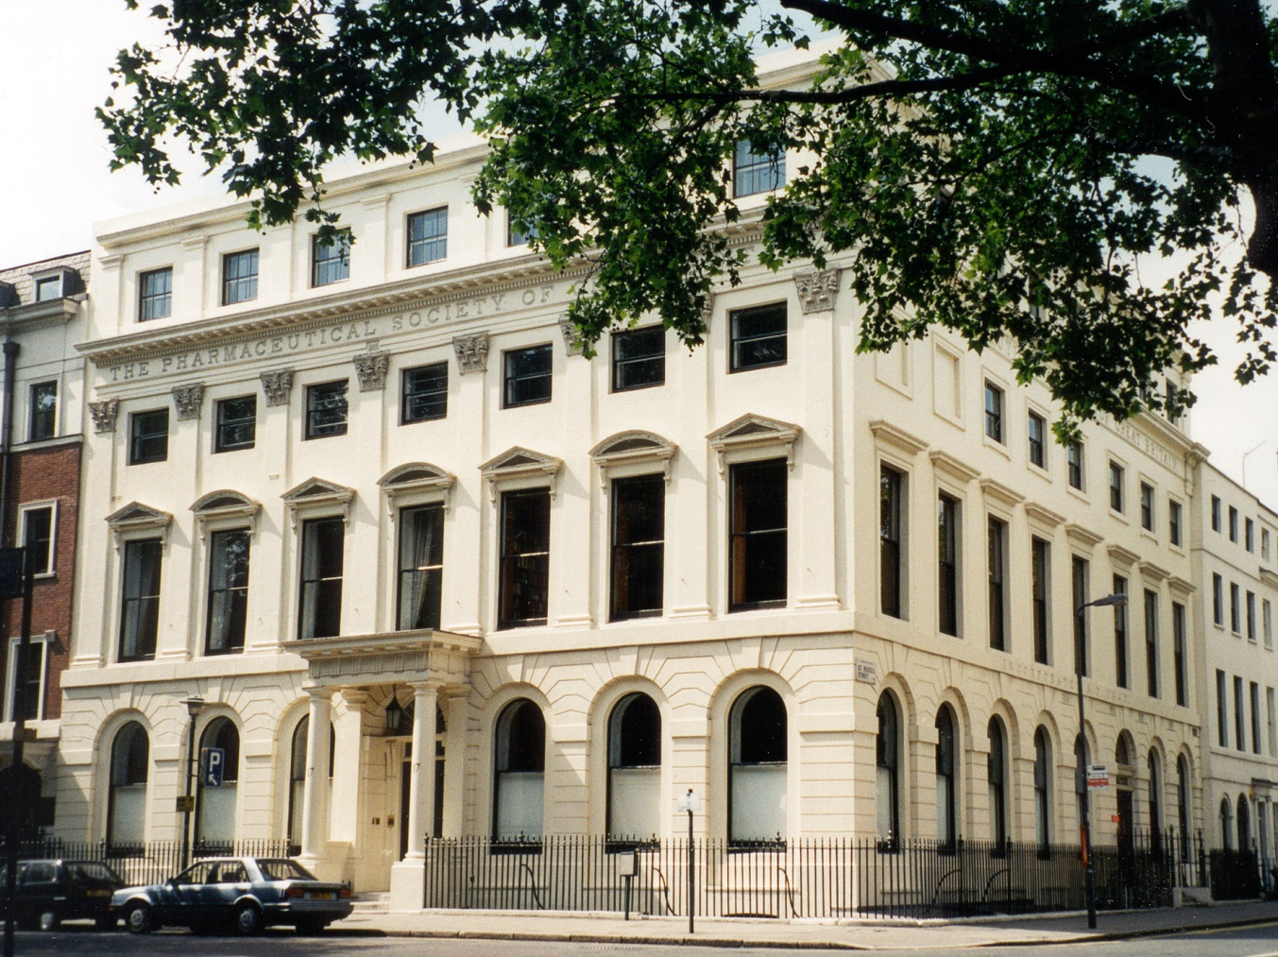

Slide 4
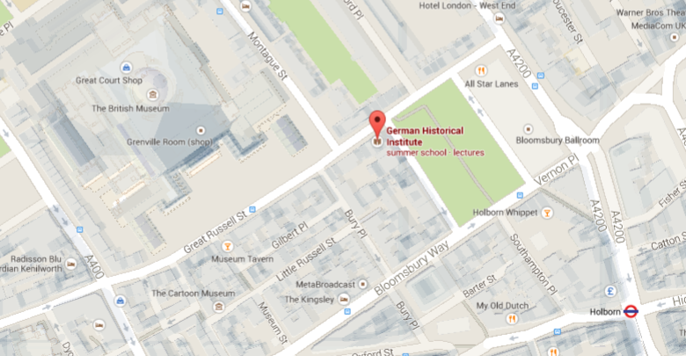

Slide 5
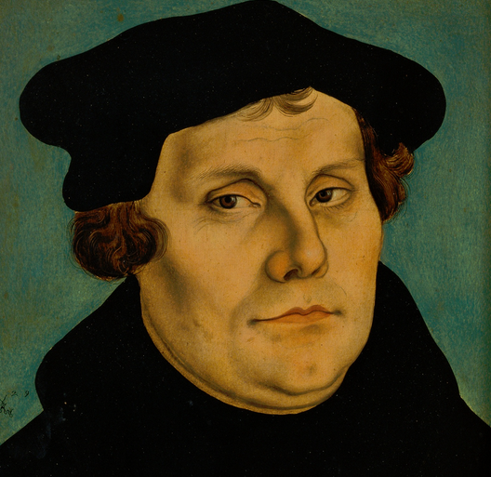
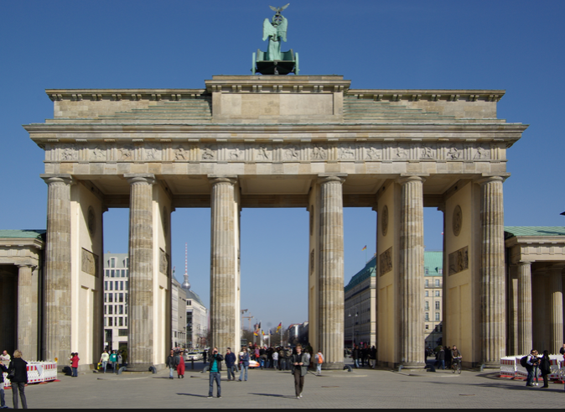
The GHIL Library specialises in German history and Anglo-German relations from the Middle Ages to the present day.

Slide 6
Largest specialised library on German history in the UK
90.000 books in German and English

Slide 8
Quiet and spacious work areas
in a beautiful historical building

Slide 9
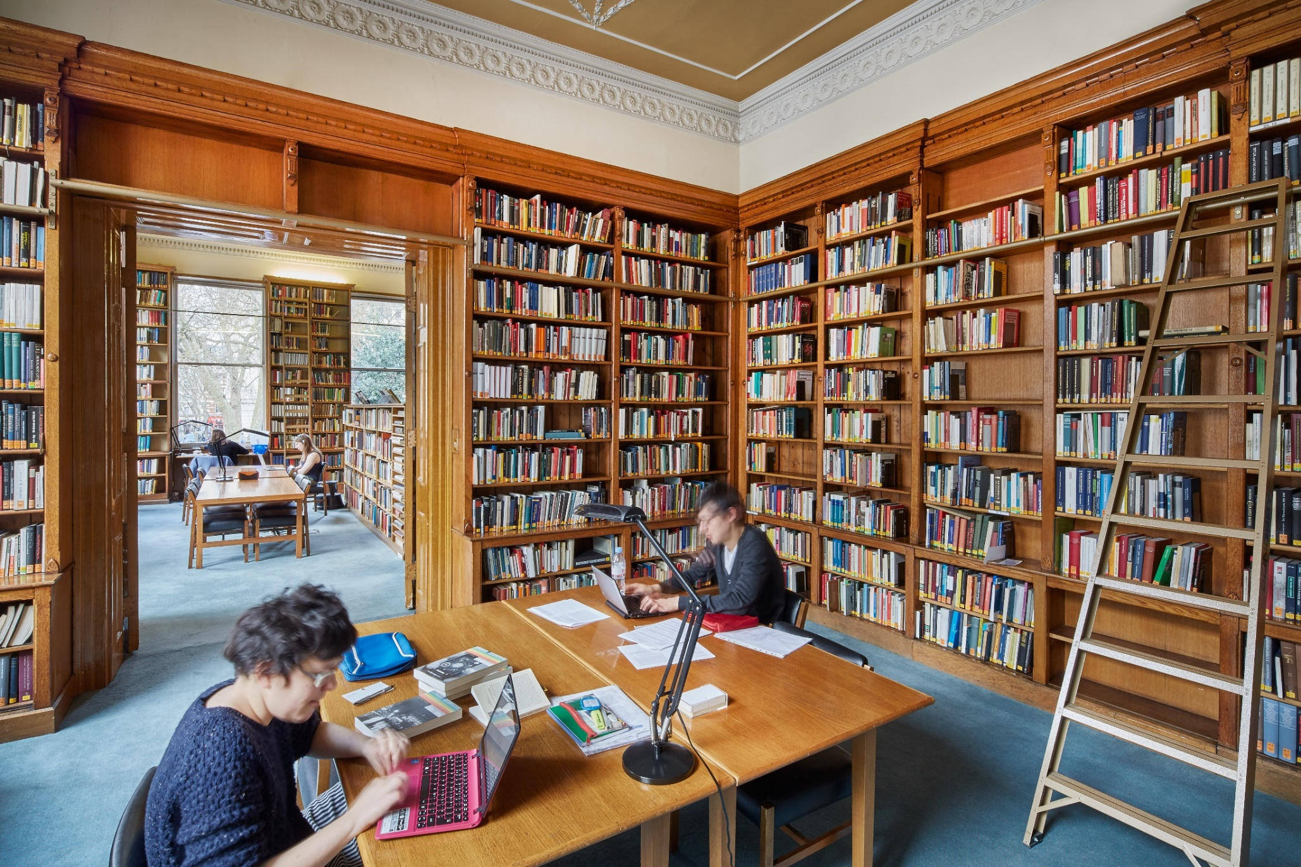

Slide 10
Library catalogue available online at
www.ghil.ac.uk

Slide 11
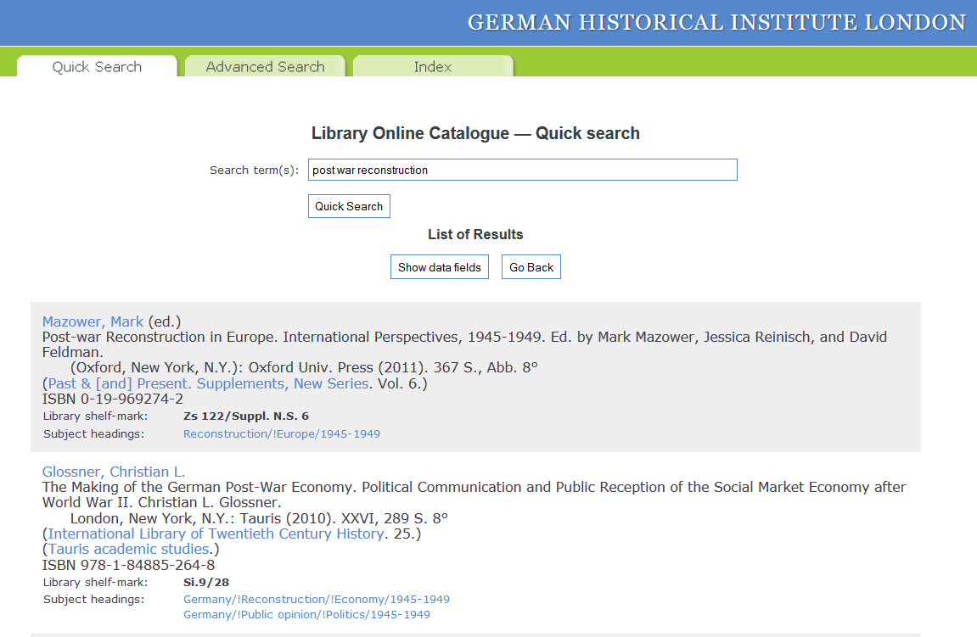

Slide 12
Subscriptions to 200 periodicals including all important German regional history journals
Growing number of electronic resources (databases, eJournals, eBooks)

Slide 13
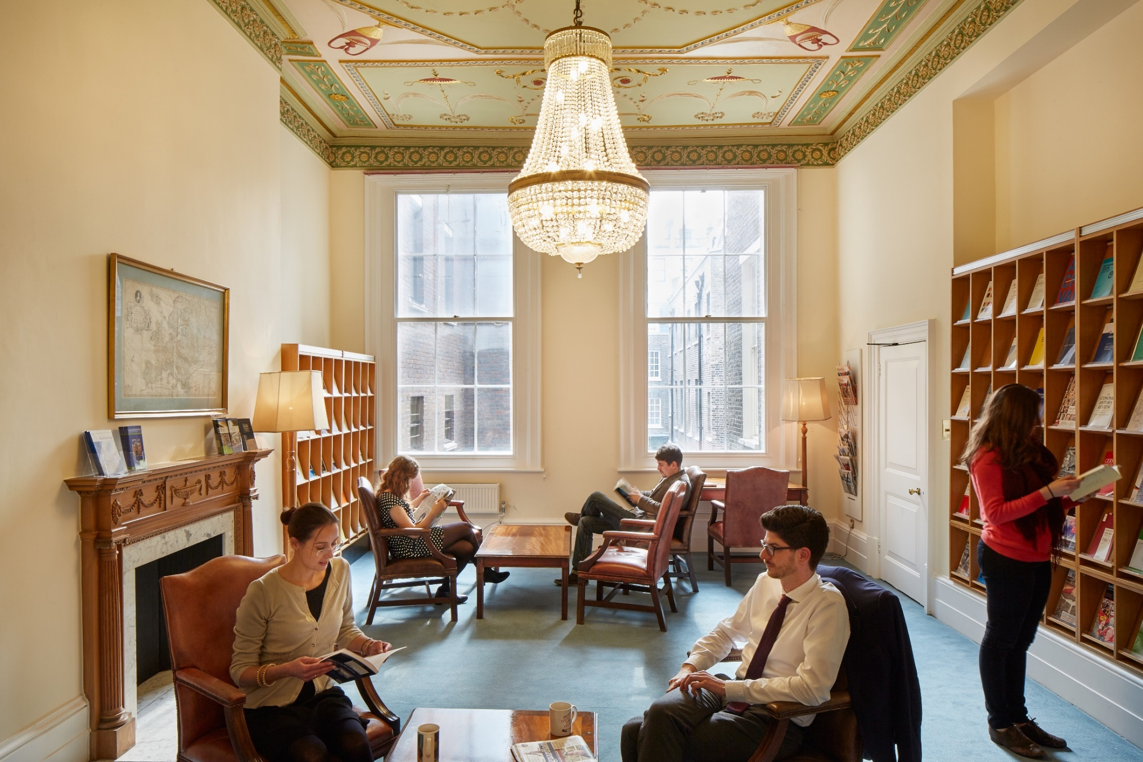
Common Room

Slide 14
Facilities for scanning
(no charge)
Free wifi and internet access

Slide 15
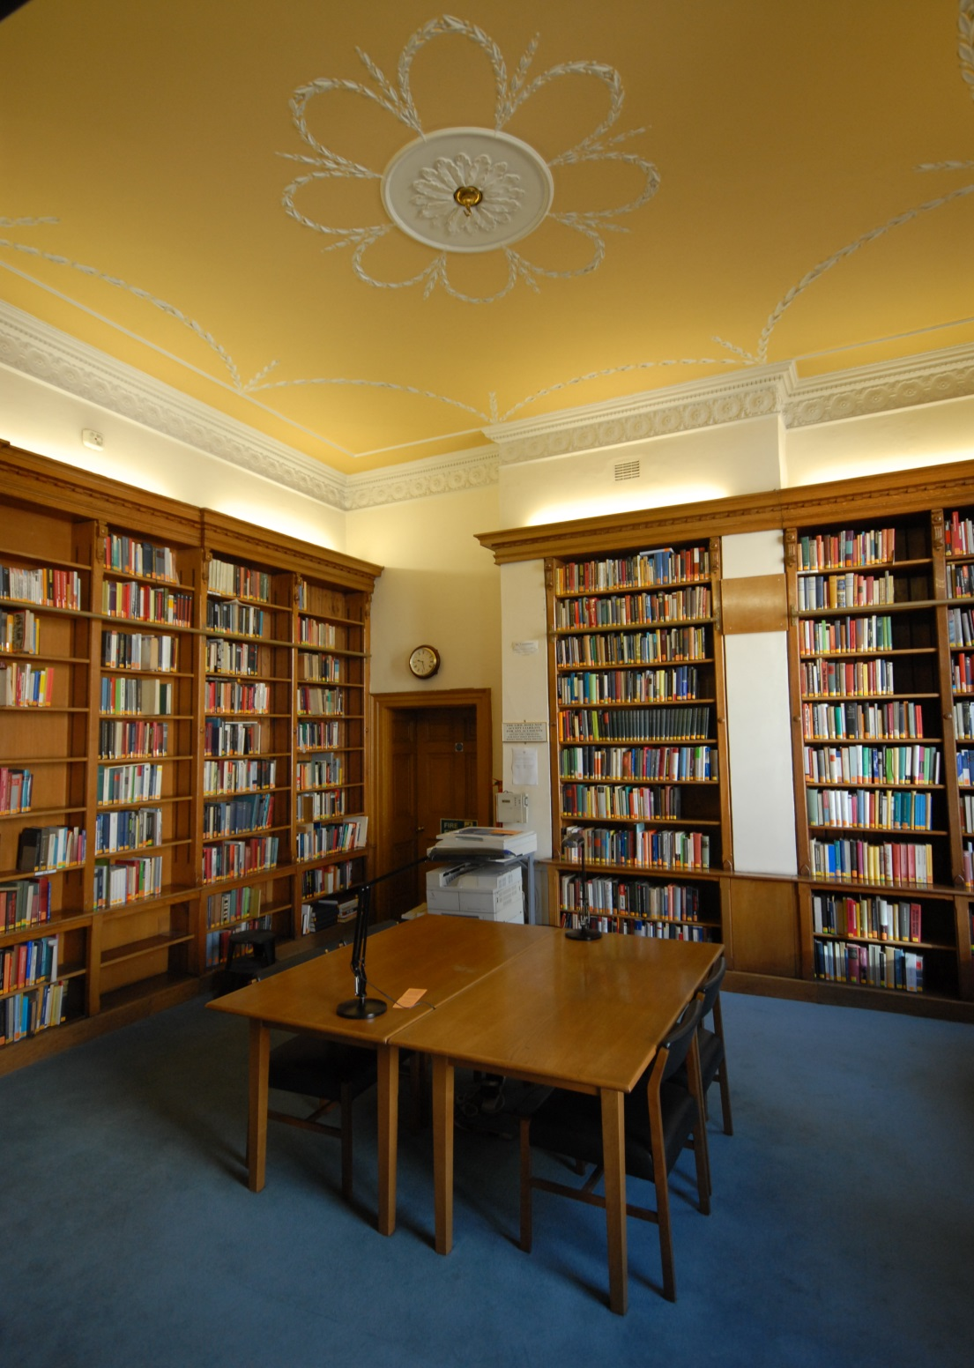

Slide 16
Library staff are happy to answer enquiries and assist with research.
Most books are easily accessible on open shelves (all others can be ordered at short notice) but cannot be taken out on loan.

Slide 17
Covid-19
Please check our website for current opening times www.ghil.ac.uk.
Registration appointments and desks must be booked in advance at library@ghil.ac.uk.

Slide 18
Covid-19
If you can’t make it to Bloomsbury Square but need something from our collections, we may be able to offer a limited facility to email you scans. Please let us know what you need at library@ghil.ac.uk.

Slide 19
Contact
German Historical Institute Library 17 Bloomsbury Square London WC1A 2NJ
Tel. +44-(0)20-7309 2050 Email: library@ghil.ac.uk

Slide 20
We hope you will pay us a visit!
GHIL Blog

